Slide 1


Recording, Analyzing and Using Physiological Signals in Psychology
Dominique Makowski
D.Makowski@sussex.ac.uk
04/2024 Workshop at

Slide 2
Signal Acquisition

Slide 3

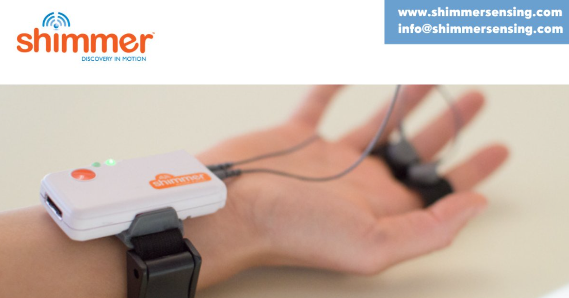
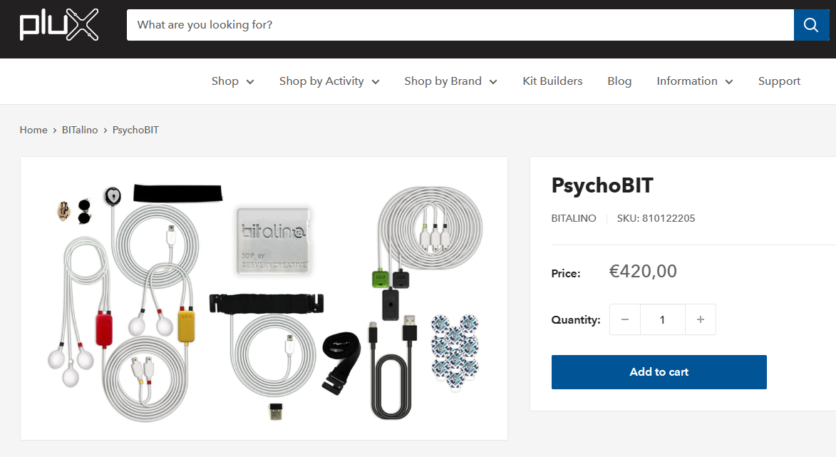

Equipment
Examples of brands
Biopac (comes with AcqKnowledge software)
BITalino (PluX)
Shimmer
…

Slide 4
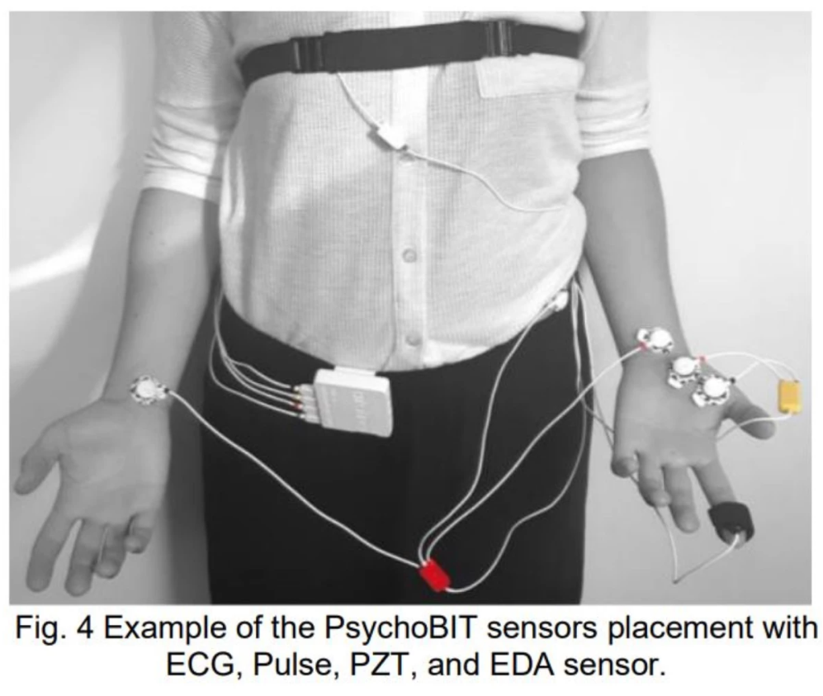
Components
Sensors
E.g., Electrodes
Measure « raw » (analog) biosignals
Amplifier / transmitter
Transforms input into digital signals and transmitted to a receiver
Receiver & Recording software
E.g., Acqknowledge; OpenSignals, …
Records and saves data

Slide 5
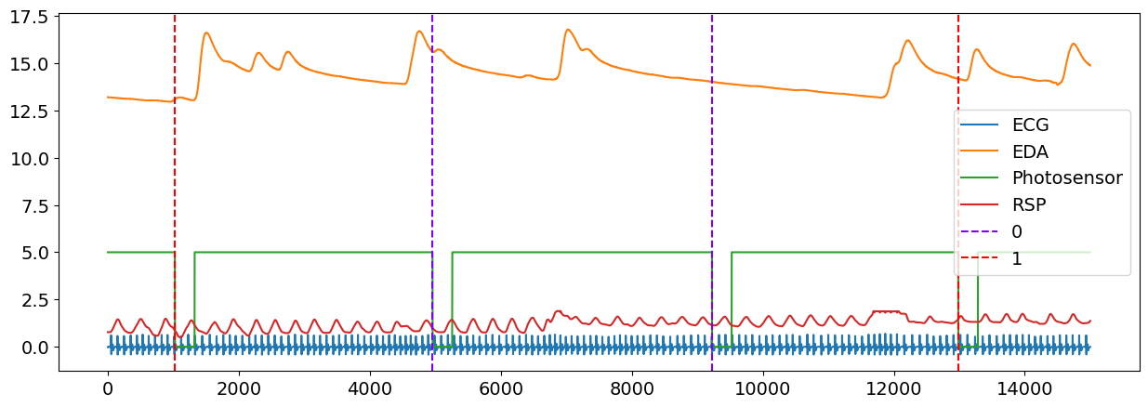
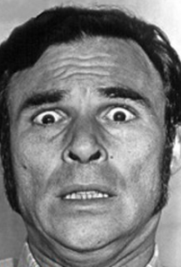
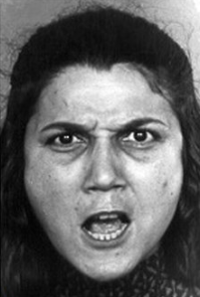
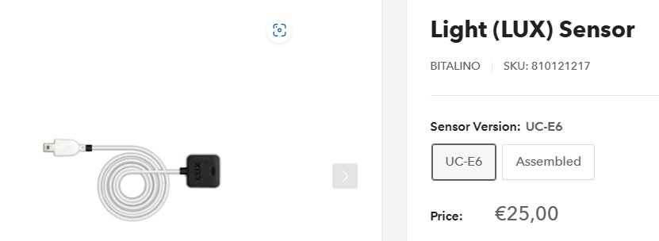
Triggers
Most experiments require to mark « events » in the signal, to facilitate data processing
Beginning / end of a phase
Stimuli onset
…
Different ways of sending triggers (« marking events »)
Digital triggers
The experiment software (e.g., PsychoPy, E-prime) sends a marker to the acquisition software when it orders to display a stimulus
Can be imprecise (unknown delay between when the trigger is send until when the stimulus is actually displayed on the screen)
Physical triggers
Capture directly what happens e.g., on the screen
E.g., using a “photosensor” (aka LUX) that records brightness
More precise (records when the event actually occurred on the screen)
+
+

Slide 6


Typical Pipeline
Experiment
Software
Display experiment
Screen
Signal preprocessing + Feature extraction
Event markers
Behavioural data
Acquisition
Software
Physio data
Behavioural Data
Physio Data
Stimulus | Condition | Answer | RT
image1 | positive | RIGHT | 780
image2 | negative | RIGHT | 845
image3 | positive | LEFT | 712
image4 | negative | RIGHT | 678
HeartRate_Mean | SCR_Amplitude | Cardiac_Phase
82 | 0.68 | Systole
78 | 0.74 | Diastole
94 | 0.56 | Systole
86 | 0.64 | Systole
Statistical analysis
+

Slide 7

Let’s do it!

Slide 8
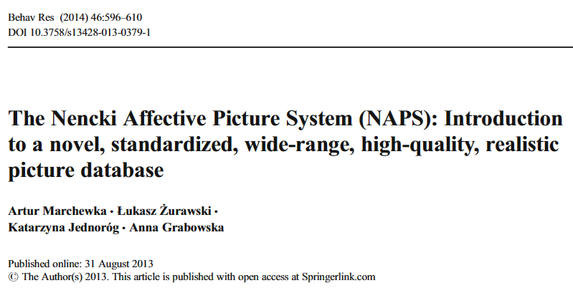
About the experiment
6 stimuli
Validated affective database (NAPS)
Presented for 4s
ISI = 8s
Conditions
Neutral
Negative
“Positive” (erotic)
Goal
1) What are the effect of condition on physiology
2) Does it correlate with subjective states?

Slide 9

Thank you
Dominique Makowski
D.Makowski@sussex.ac.uk

